Slide 1

AntsDB
MySQL Compatibility for HBase
August 17,2018

Slide 2
Content
01
About Us
02
Scenario
03
Architecture
Complementary to HBase
04

Slide 3
About Us
01

Slide 4
Water Guo
Founder of AntsDB
Love Hadoop and HBase but a heavy RDB user in the past
Love programming for extreme performance
Previously Software Architecture at Informatica, DataMirror, founder of BDI Systems.

Slide 5
AntsDB
Open source project at https://github.com/waterguo/antsdb
Problem to resolve: NoSQL is taking over the world but majority of the data applications are still using RDB
Database virtualization software
Attempt to bring MySQL compatibility to HBase

Slide 6
Scenario
02

Slide 7
Virtual Telephone Number
Telecom industry
Rigid latency requirement: 20ms max
Data is growing fast
Built on top of relational database - MySQL

Slide 8
Solution Architecture
User Application
Batch Analytics
Spark SQL
AntsDB
HBase

Slide 9
Lessons Learned
What we like HBase
What we were struggling
Linear scalability
Hadoop ecosystem
Good random access performance
Latency spike
Transaction
Join performance

Slide 10
Why don’t cache hot data
Operational data = hot data
Historical data = majority of big data
Daily hot data = 1-5%
Weekly hot data = 5-10%
Monthly hot data = 10-15%

Slide 11
Silver bullet - caching
Large amount local caching using SSD – 500 GB
Local data fetch -> sub-millisecond latency
Distributed transaction -> local transaction
Distributed joins -> local joins

Slide 12
AntsDB Architecture
03

Slide 13
Layers
MySQL Network
JDBC, ODBC, PHP, Python, Native
1
2
SQL Parser/Executor
MySQL syntax, functions, data types
Transaction
3
MVCC, row locking
4
Caching
HBase Connectivity
Data in and out from HBase

Slide 14
Architecture
Subtitle Text
AntsDB
SQL Parser
Application
MySQL Driver
Query Executor
Query Result
Transaction Manager
Local Cache
Transactions
HBase Cluster
HBase Connector
Query Result

Slide 15
Fight the GC
Java Unsafe - skip list, cache, WAL, row locking, cursor
Atomic operation for row locks
Small heap size - less than 4G
Escape analysis
Scan performance : 1 million rows / thread / second
Insert performance: 200K inserts / thread / second

Slide 16
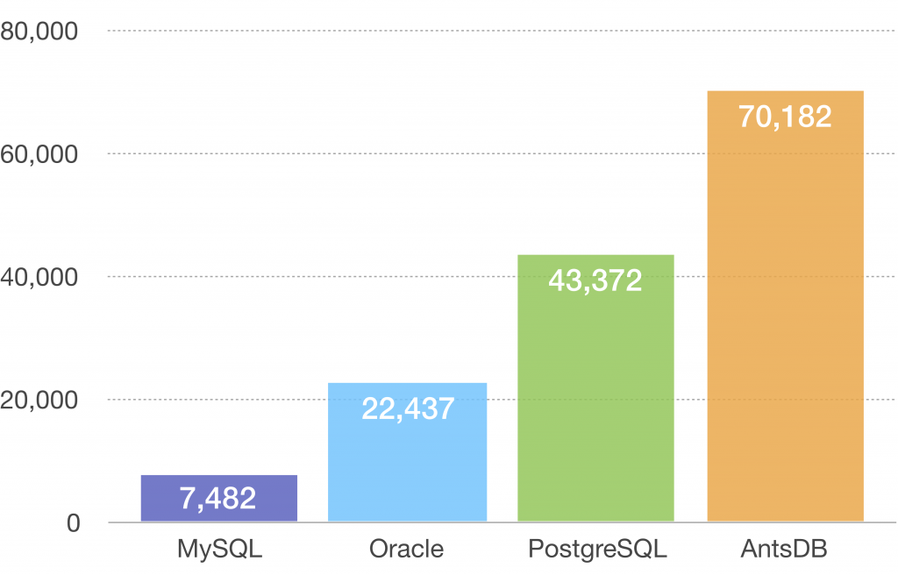
Performance - YCSB write

Slide 17
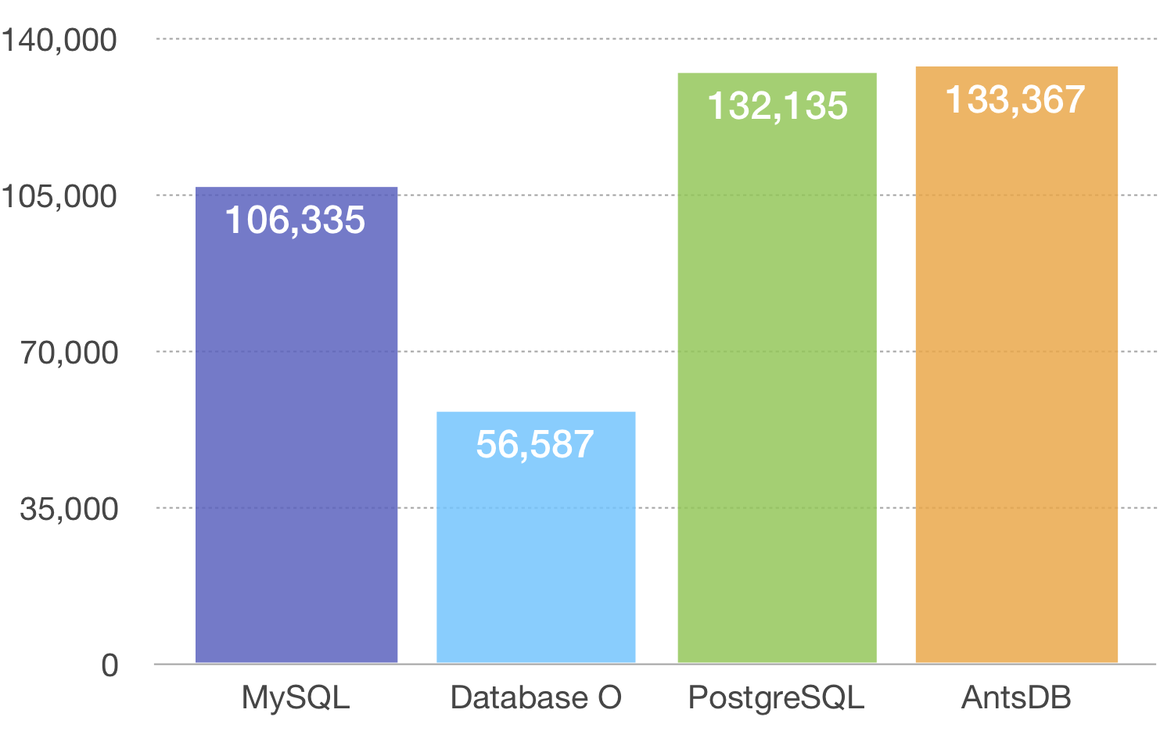
Performance - TPCC

Slide 18
Complementary to HBase
04

Slide 19
MySQL Compatibility
MySQL protocol – JDBC, ODBC, PHP, Python, Native
Core SQL syntax
MySQL data types
MySQL functions – 45
Low latency transactions
Low latency joins
Indexes - Unique, non-unique, full-text

Slide 20
MySQL Behaviour Simulation
Locking
Commit and rollback
MVCC
Quirks such as 0000-00-00 00:00:00 datetime, zerofill integers
Millisecond latency

Slide 21
Compatible applications
MySQL command line utilities
MySQL Workebench
DBeaver
SquirrelSQL
MediaWiki
SonarQube
PHPMyAdmin
BechmarkSQL – TPC-C benchmarking
YCSB

Slide 22





Next step
High availability
Cluster
Low latency CP system

Slide 23
Thanks

